Slide 1
FEDERAL REPUBLIC OF GERMANY
UNIVERSITY OF EUROPE FOR APPLIED SCIENCES
POTSDAM CAMPUS
Decision Tree ML model for Iris plant dataset classification problem
Career: Software Engineering
Machine Learning
Semester: Summer
Sebastian Russo
Potsdam, July, 2024

Slide 2
DATASET

Slide 3
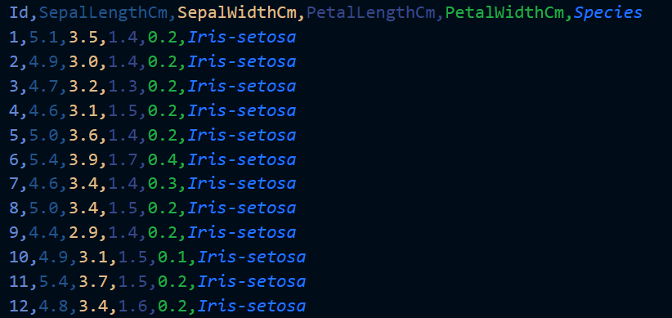
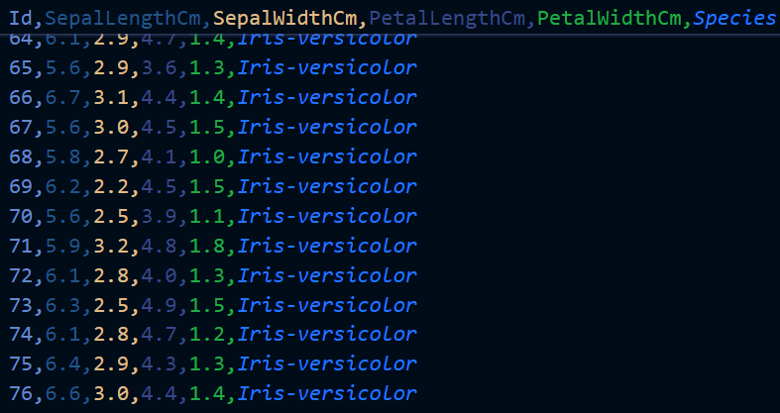
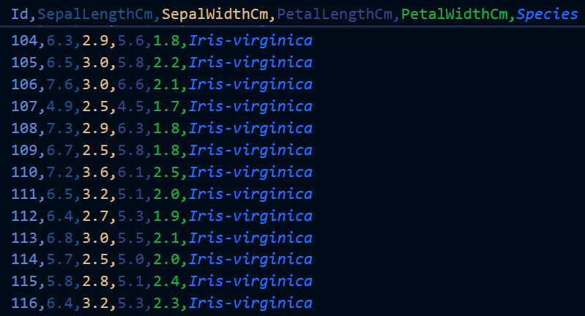
The dataset
-Consist in a dataset of 3 species of Iris flower (Setosa, Versicolor and Virginica)
-Has 150 data points that are equally divided in 3 classes (50 Setosas, 50 Versicolors and 50 Virginicas)
-It is fully sorted; therefore [1,50]=Setosa, [51,100]=Versicolor and [101,150]=Virginicas
-Has 6 columns; a single ID column, 4 Feature (Petals and Sepals) columns and 1 Class column (Species)
-It constitutes a Supervised learning, Multinomial classification problem

Slide 4
CODE

Slide 5

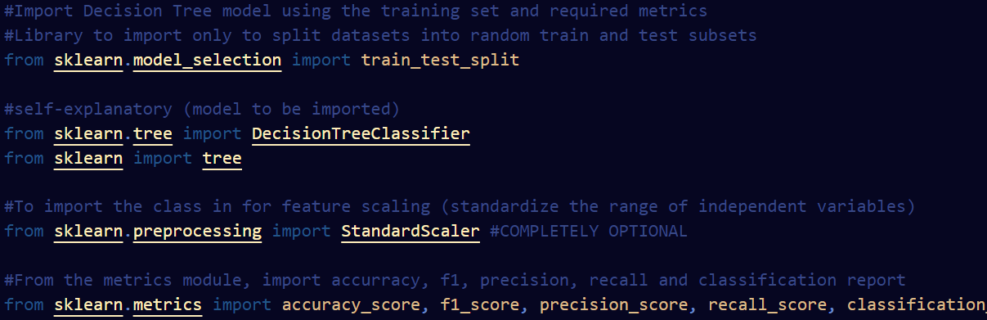
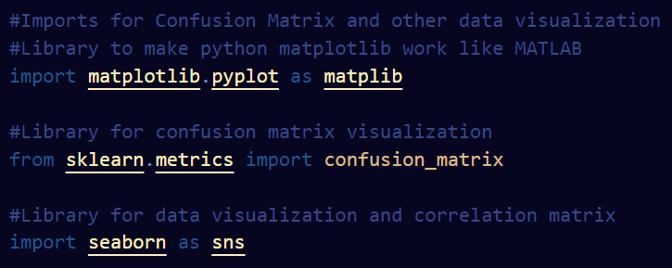
Imports

Slide 6
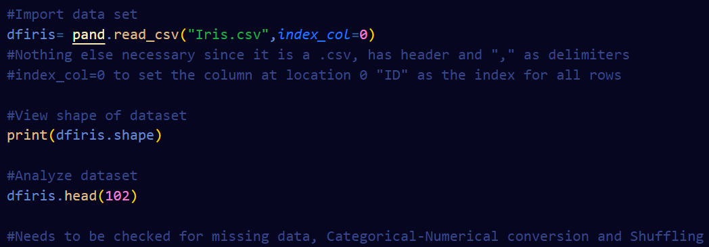
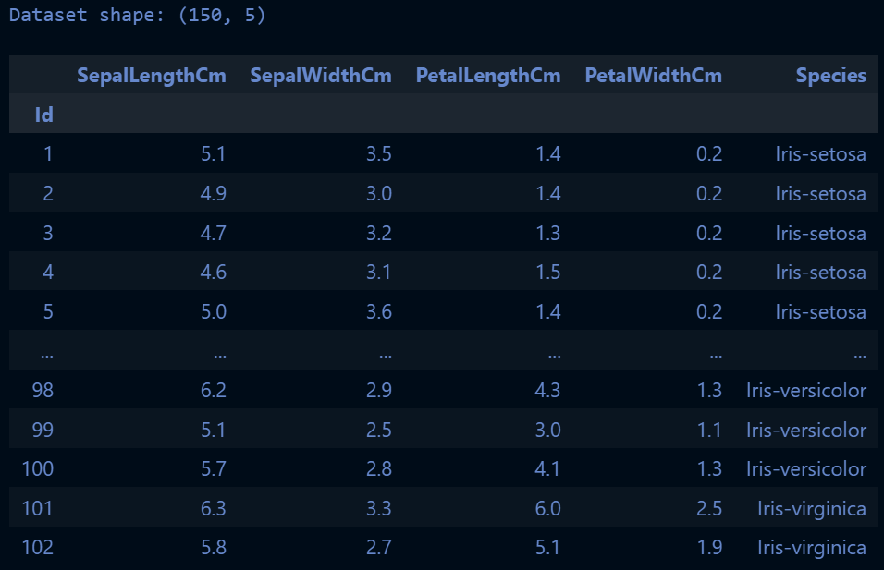
Dataset import and analysis (.csv file)
Output
Py cell
-There is already a column for ID, might as well use it as index column

Slide 7
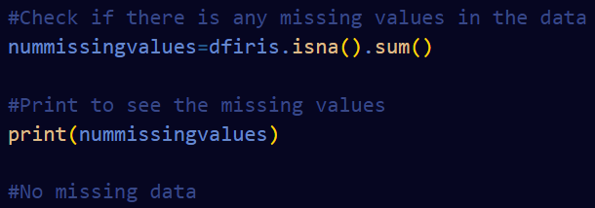
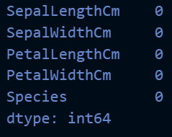
Missing value check
Output
Py cell
-This ensures there are no null data that might make the model run into an error

Slide 8
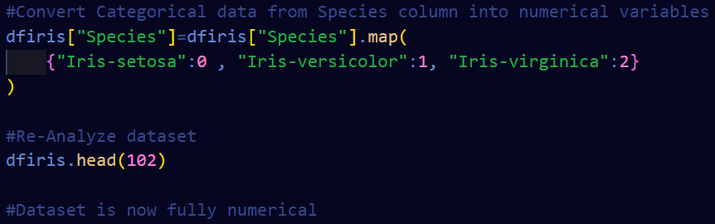
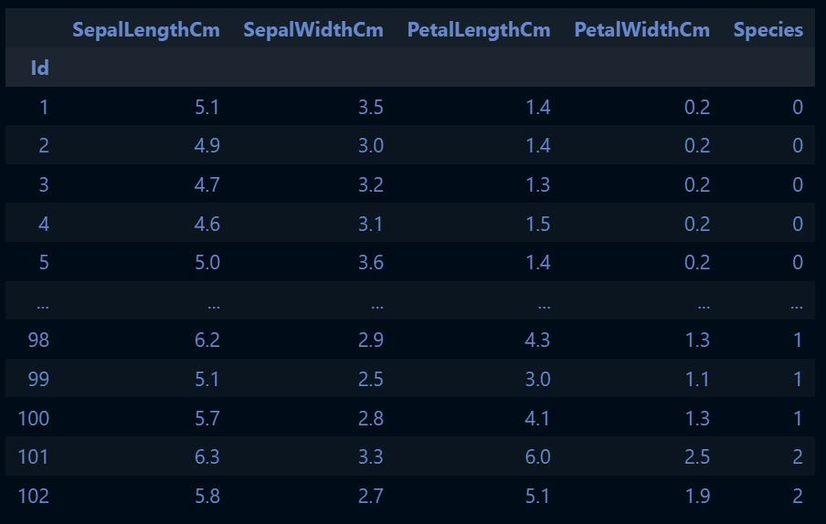
Categorical data conversion
Output
Py cell
-This ensures the model is processable (it expects numbers, not Strings)

Slide 9
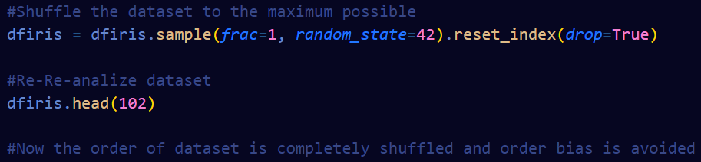
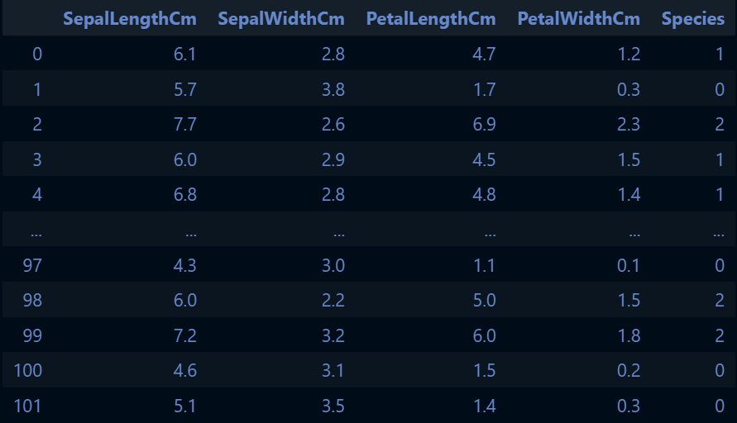
Dataset necessary shuffling
Output
Py cell
-This avoids Temporal and Order bias
-Improves randomness and robustness

Slide 10
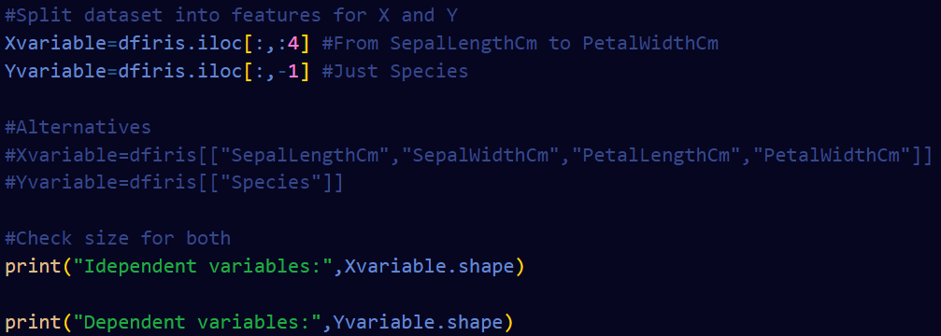

Dataset splitting (Dependent and Independent)
-Takes “Species” as the Y variable and the rest as X variables
Py cell
Output

Slide 11
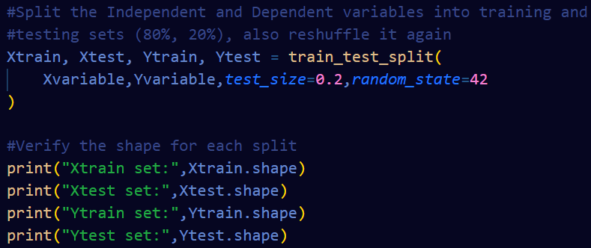
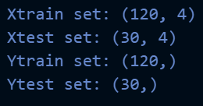
Training and Testing splitting
-Set random state for further shuffling (it improved performance)
-Divides both X and Y variable into 2 groups for training and 2 groups for testing
Py cell
Output
-A 75-25% and 85-15% split was tried
-80-20% was the most optimal

Slide 12
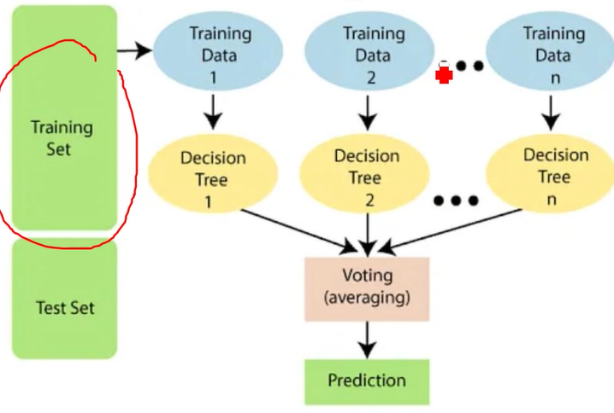

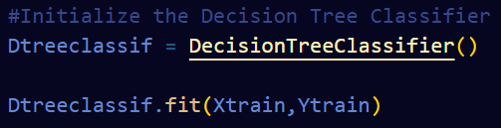

Feature scaling and model training
Py cell
Py cell
-Another random_state was tried but it decreased the model’s performance
Output

Slide 13
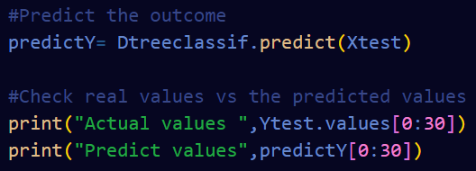
Outcome prediction; actual vs predicted values
-We put the first 30 predicted values against the first 30 predicted actual values
Py cell
Output

Slide 14
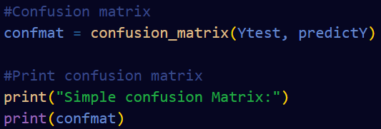
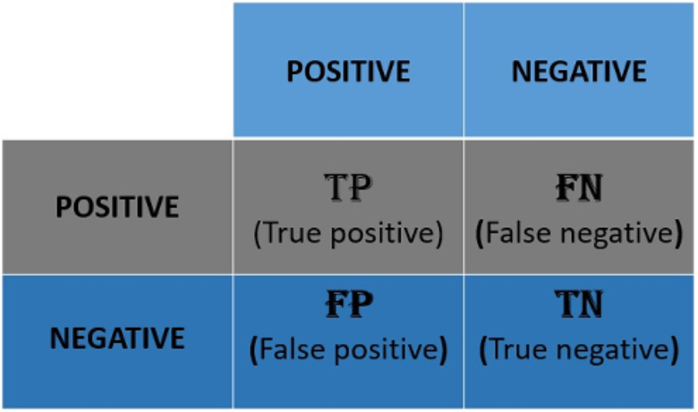
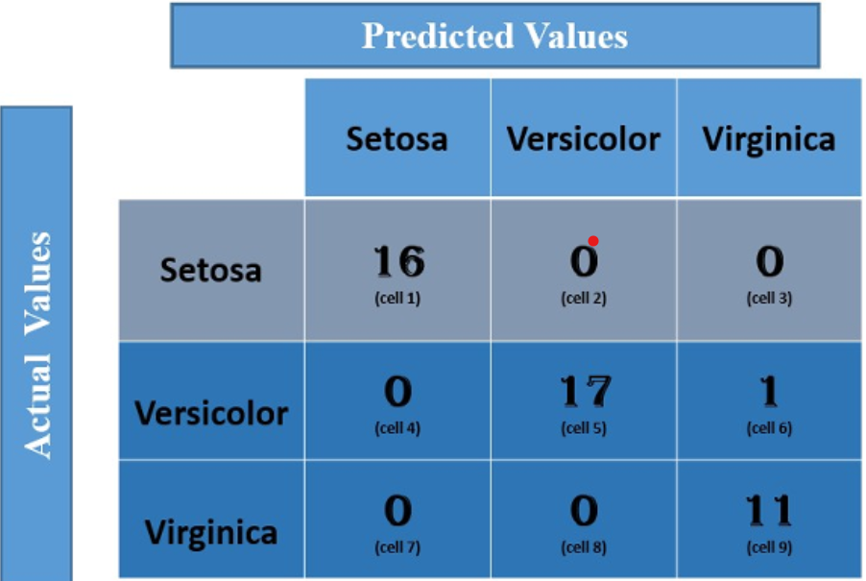
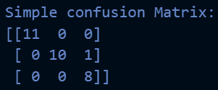
Model performance visualization, pt.1
Py cell
NOT THE ACTUAL CASE
Output

Slide 15
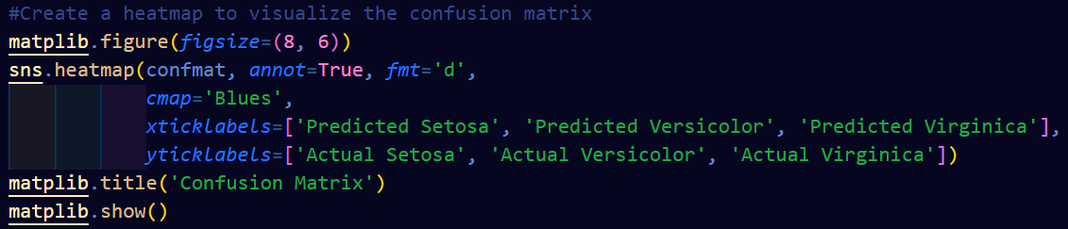
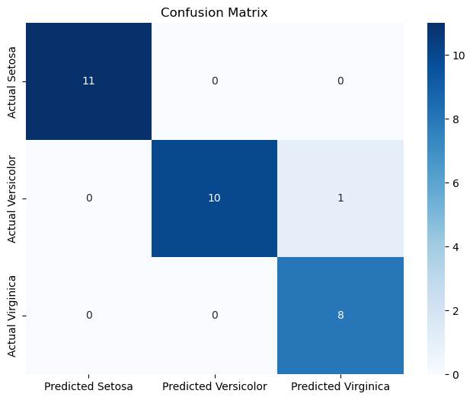
Model performance visualization, pt.2
Output
Py cell

Slide 16
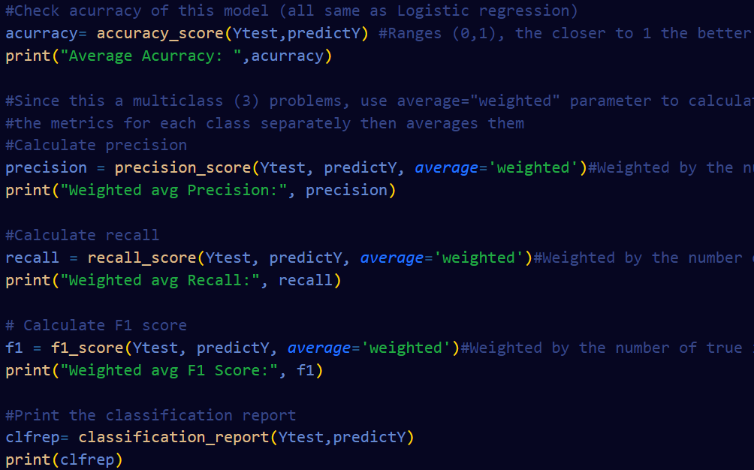



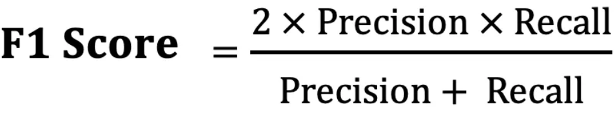
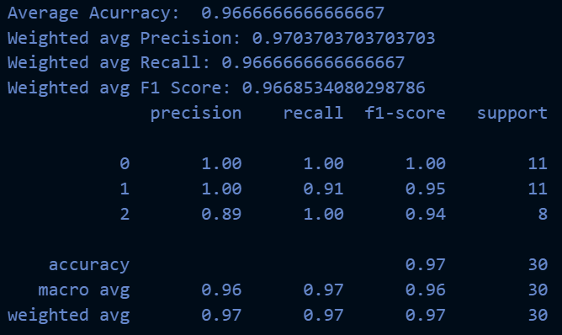

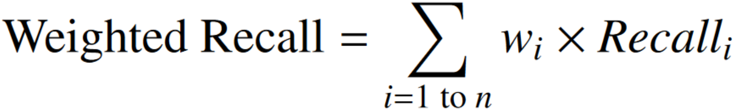

Model performance Metrics
TP + TN
-------------------
(TP+TN+FP+FN)
TP
-----------
(TP+FP)
TP
-----------
(TP+FN)
Output
Py cell

Slide 17
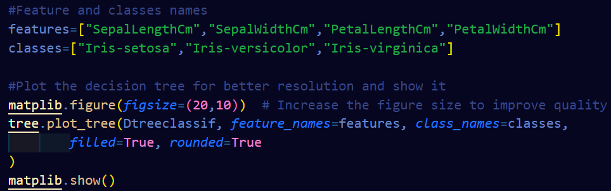
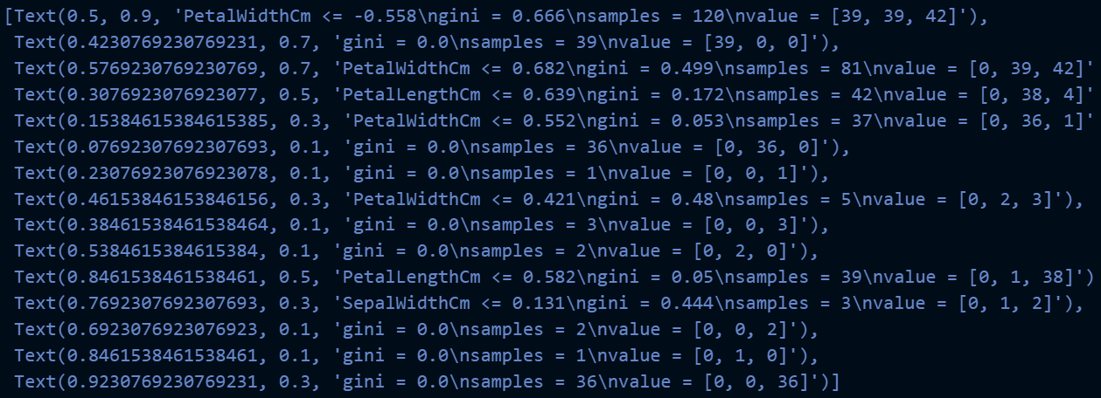
Decision Tree Diagram pt.1
Py cell
Output

Slide 18
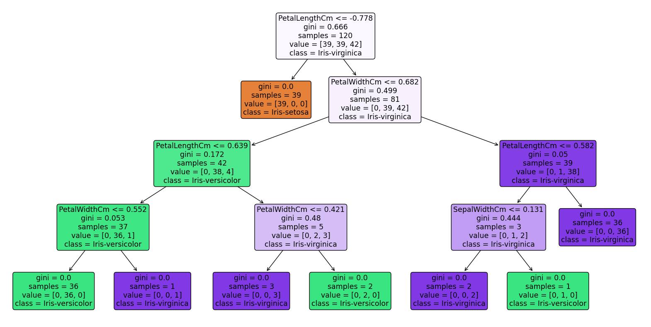
Decision Tree Diagram pt.2
3 classes
Petal length
1 class
2 classes
Petal width
2 classes
2 classes
Petal length
2 classes
2 classes
2 classes
1 class
Petal width
Sepal width?
1 class
1 class
1 class
1 class
1 class
1 class

Slide 19
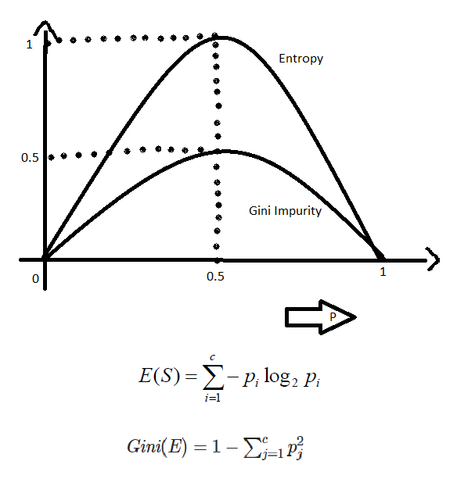
Decision Tree Diagram pt.2
-PetalLengthCm and PetalWidthCm: These features provide significant separability between the species, especially Iris-setosa from the other two species. They often create the initial splits in the decision tree, making them appear frequently when the code is run.
-SepalLengthCm and SepalWidthCm: These features might not provide as much separability, so maybe that is why they are less likely to be chosen for splits, especially in the higher levels of the tree.
-Lower Information Gain: If SepalLengthCm or SepalWidthCm doesn’t significantly reduce the Gini impurity compared to other features, it won’t be chosen for splits and already used features are re-used.
-Data Patterns: The specific patterns and distributions of your dataset determine the splits. For the Iris dataset, the patterns in petal measurements are more distinct across classes than sepal measurements.

